Slide 1

Machine Learning with
A Machine learning framework from Microsoft
Praveen Raghuvanshi

Slide 2

Introduction
Cloud Architect @ Harman
Domain: Audio, Video, Control
Area of Expertise: Cloud, Distributed computing
Area of Interest: AI/ML, Cloud and IoT

Slide 3
Prerequisites
http://bit.ly/2DijYAl
Poll
live.voxvote.com

Slide 4
Identify language
Bonjour
Guten Morgen
おはよ ございます
Good Morning

Slide 5

Programming Languages
Source: https://insights.dice.com/2019/10/24/tiobe-top-eight-top-ten-open/

Slide 6
Quiz : Type of ML
Is this A or B?
How much – or – How many?
How is this organized?
What should I do next?
Is number a Armstrong?

Slide 7
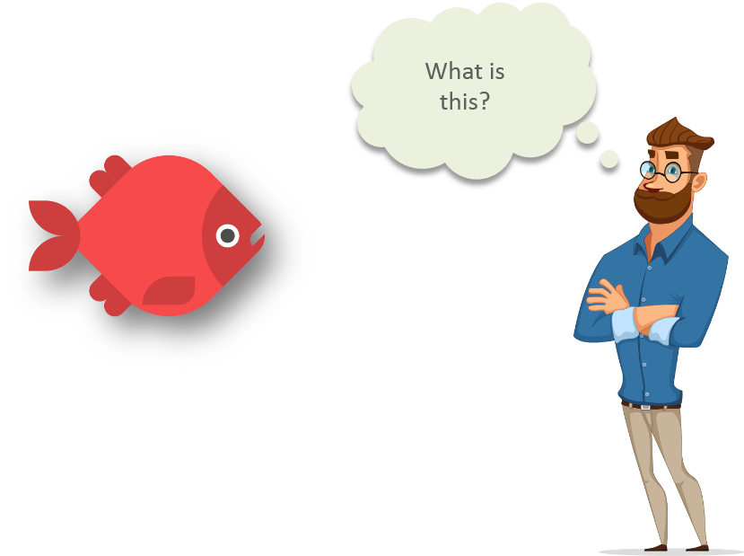
Machine Learning
Intellpaat: https://www.quora.com/What-are-prerequisites-to-start-learning-machine-learning

Slide 8
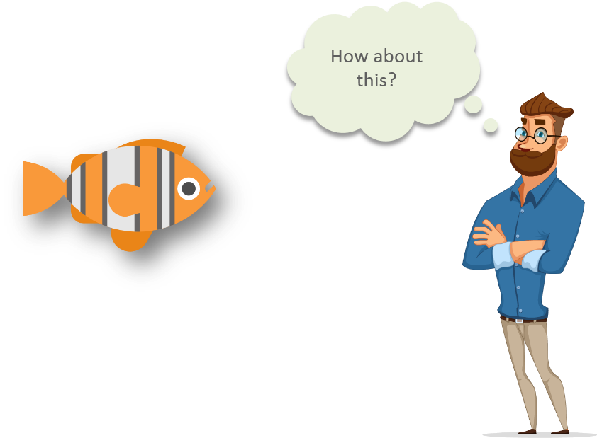
Machine Learning
Intellipaat: https://www.quora.com/What-are-prerequisites-to-start-learning-machine-learning

Slide 9
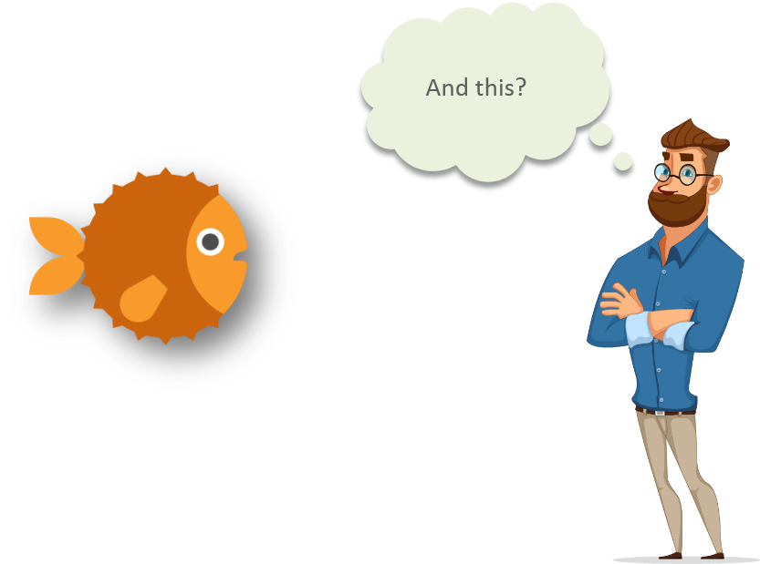
Machine Learning
Intellipaat: https://www.quora.com/What-are-prerequisites-to-start-learning-machine-learning

Slide 10
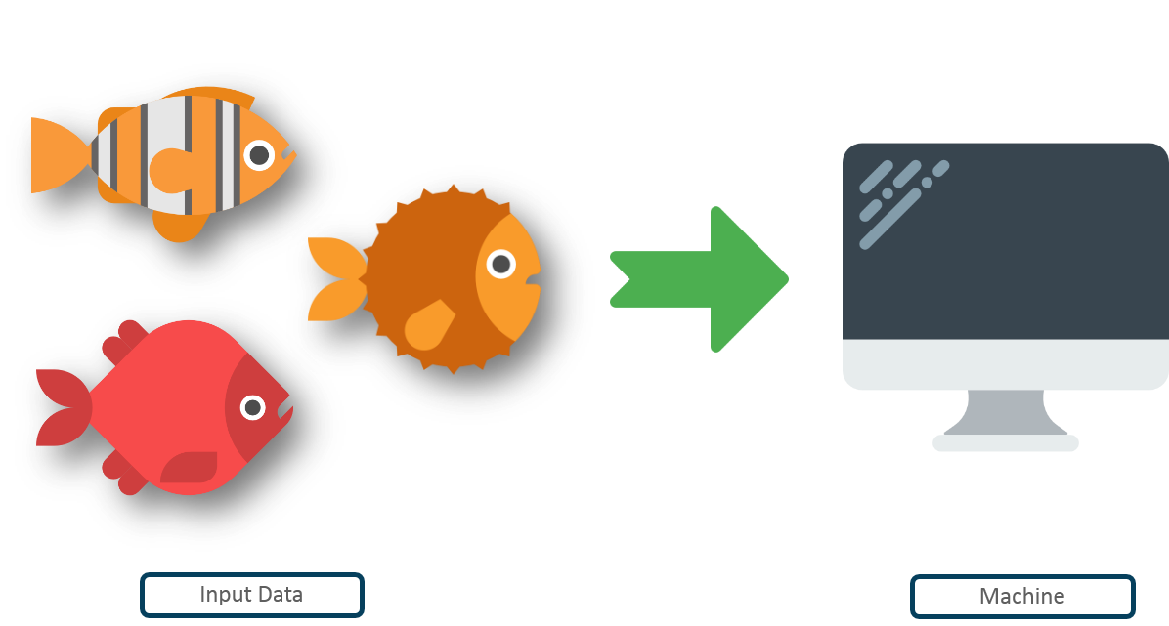
Machine Learning
Intellipaat: https://www.quora.com/What-are-prerequisites-to-start-learning-machine-learning

Slide 11
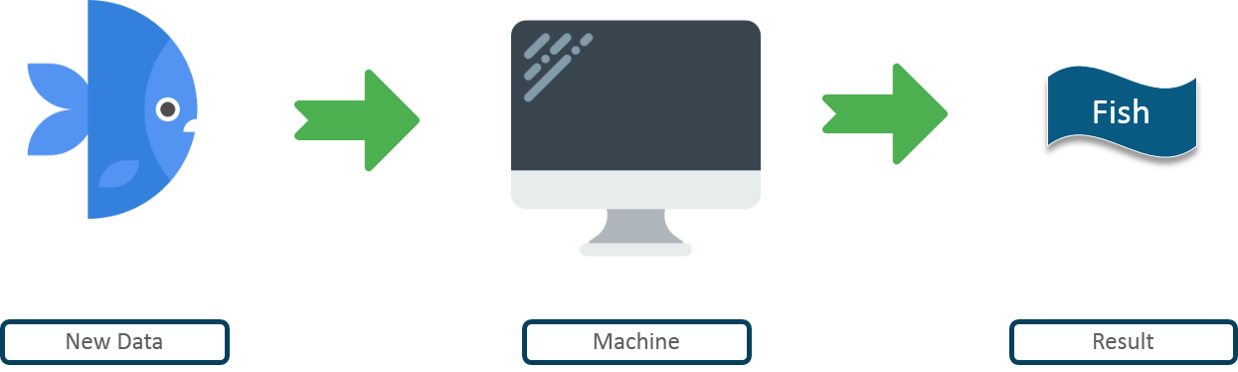
Machine Learning
Intellpaat: https://www.quora.com/What-are-prerequisites-to-start-learning-machine-learning

Slide 12
Machine learning
Machine learning is getting computers to program themselves.
If programming is automation, then machine learning is automating the process of automation
Traditional Programming
Machine learning
Data
Program
Output
Data
Output
Program
Computer
Computer

Slide 13
Pre-Requisites of ML
A Pattern should exist
Mathematical model / algorithm is unknown
Lots of data

Slide 14
Types of Machine Learning
Machine
Learning
Supervised
(Task based)
Unsupervised
(Data Driven)
Reinforcement
(Algorithms learns to react to an environment)
Classification
Regression
Clustering

Slide 15
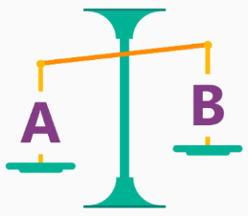
Is it A or B?
Classification Algorithm
Will this tire fail in the next 1,000 miles : Yes or No ?
Which brings in more customers: a $5 coupon or a 25% discount ?

Slide 16
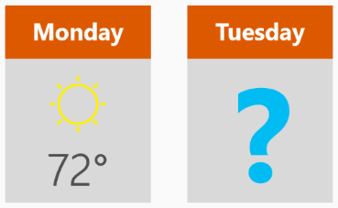
How much? How many?
Regression Algorithm
What will the temperature be next Tuesday?
What will my fourth quarter sales be?
They help answer any questions that asks for a number

Slide 17
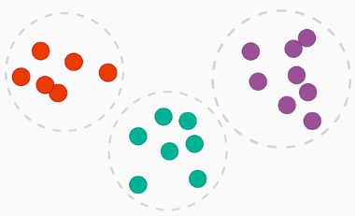
How is this organized?
Clustering Algorithm
Which viewers like the same type of movies?
Which printer model fail the same way?

Slide 18

What should I Do now?
Reinforcement learning Algorithm
If I'm a self-driving car: At a yellow light, brake or accelerate?
For a robot vacuum: Keep vacuuming, or go back to the charging station?

Slide 19
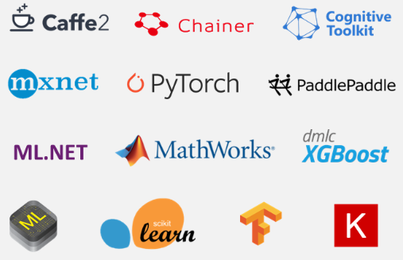
ML Frameworks

Slide 20
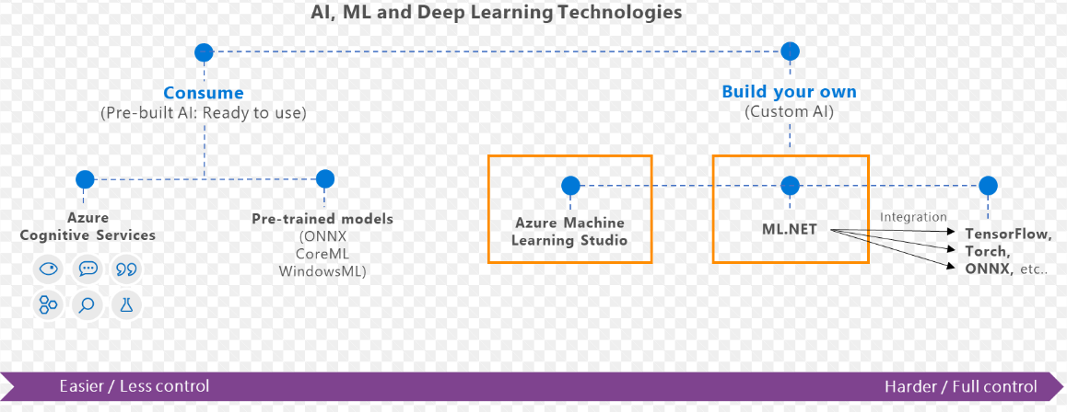
What is ML.Net?
ML framework from Microsoft for developing Custom AI/ML applications
Originated in 2002 as part of Microsoft Research project

Slide 21
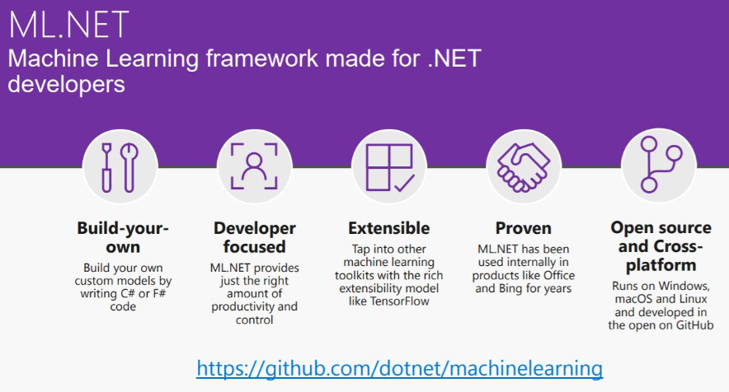

Slide 22
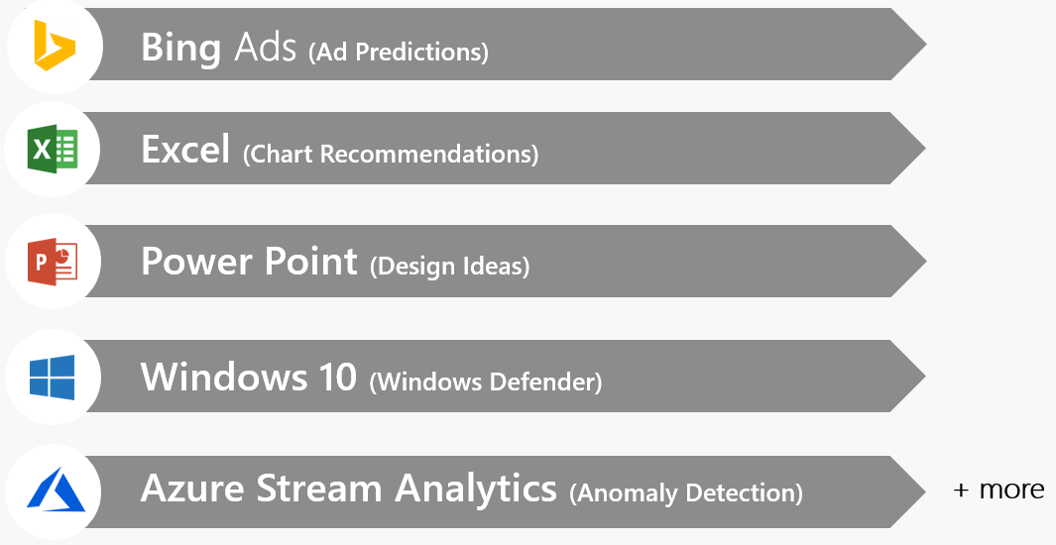
Proven at scale, Enterprise ready

Slide 23
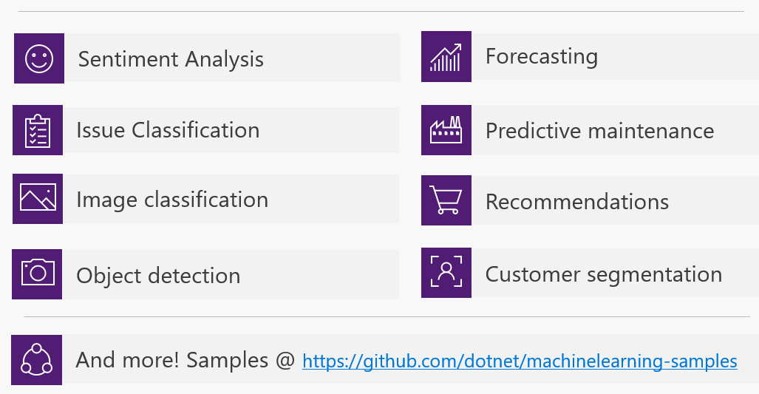
Possibilities

Slide 24
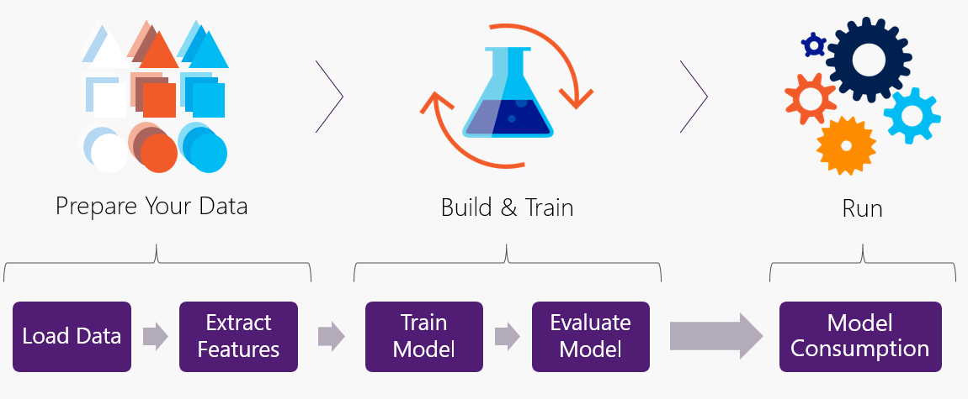
Workflow

Slide 25
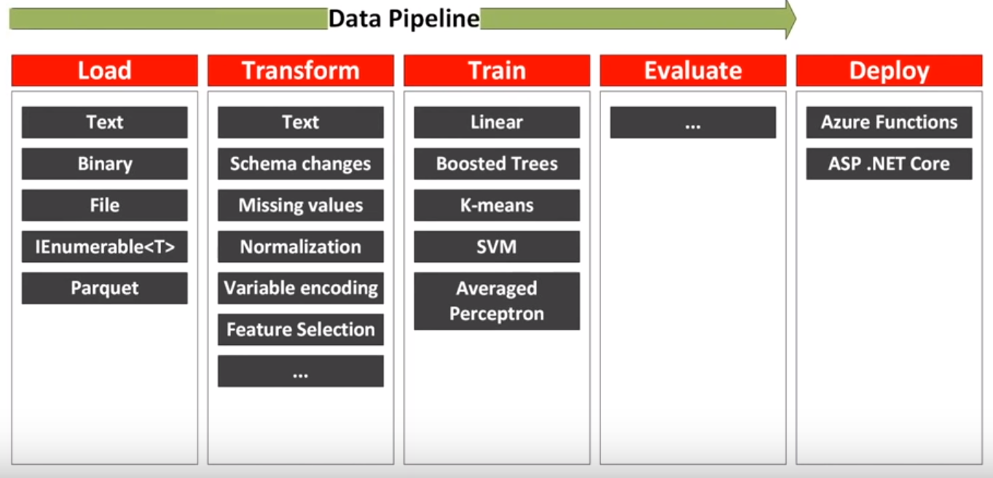
Data pipeline

Slide 26
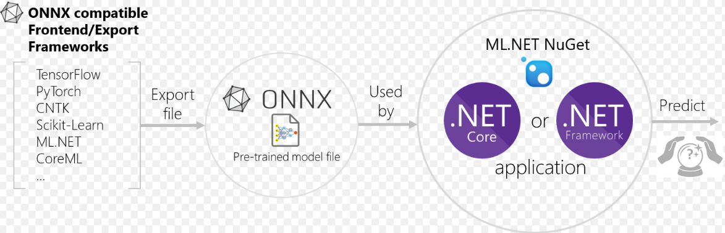
Interoperability: ONNX Open Neural Network Exchange Format
ONNX is developed and maintained by a community of partners such as Microsoft, Facebook.
ONNX files could be viewed using Netron

Slide 27
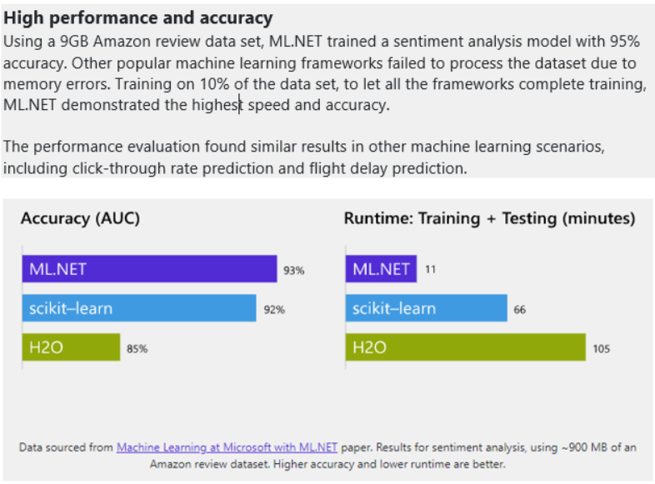
Performance

Slide 28
Code Demo(s)

Slide 29
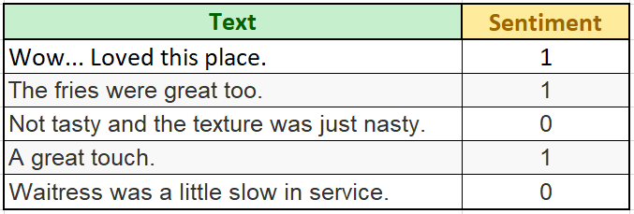
Sentiment Analysis
Positive(+ve) , Negative(-ve)
Label and Features
Train model using ML.Net
Train using AutoML
Code generation
Accuracy improvement
https://docs.microsoft.com/en-us/dotnet/machine-learning/tutorials/sentiment-analysis

Slide 30
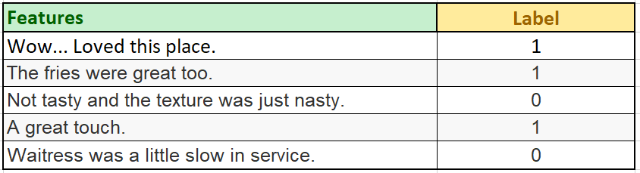
Dataset - Yelp reviews

Slide 31
Load
// Initialize ML Context
MLContext mlContext = new MLContext();
// Load : Split it into 80% training and 20% test data
var trainTestSplit = 0.2;
IDataView dataView = mlContext.Data.LoadFromTextFile<SentimentData>(_dataPath, hasHeader: false);
TrainTestData splitDataView = mlContext.Data.TrainTestSplit(dataView, testFraction: trainTestSplit);

Slide 32
Load -> Transform
// Transform : Converts the text column(SentimentText) into numeric type Features column using FeaturizeText
var estimator = mlContext.Transforms.Text.FeaturizeText(outputColumnName: "Features", inputColumnName: nameof(SentimentData.SentimentText))
.Append(mlContext.BinaryClassification.Trainers.SdcaLogisticRegression(labelColumnName: "Label", featureColumnName: "Features"));

Slide 33
Load -> Transform -> Train
// Train/Fit model
var model = estimator.Fit(splitDataView.TrainSet);

Slide 34
Load -> Transform -> Train -> Evaluate
// Evaluate : Evaluate performance of the model using Test set
IDataView predictions = model.Transform(splitDataView.TestSet);
CalibratedBinaryClassificationMetrics metrics = mlContext.BinaryClassification.Evaluate(predictions, "Label");

Slide 35
Load -> Transform -> Train -> Evaluate -> Predict
// Create PredictionEngine passing above model
PredictionEngine<SentimentData, SentimentPrediction> predictionFunction = mlContext.Model.CreatePredictionEngine<SentimentData, SentimentPrediction>(model);
// Create sample text
SentimentData sampleStatement = new SentimentData
{
SentimentText = "This was a very bad steak"
};
// Predict
var resultPrediction = predictionFunction.Predict(sampleStatement);

Slide 36
Load -> Transform -> Train -> Evaluate -> Predict -> Save
// Save Model
mlContext.Model.Save(model, splitDataView.TrainSet.Schema,"model.zip");

Slide 37

Binary Classification
Titanic - Survival Prediction
Label and Features
Train model using ML.Net
Train using AutoML
Code generation
Accuracy improvement
Data: https://web.stanford.edu/class/archive/cs/cs109/cs109.1166/problem12.html

Slide 38
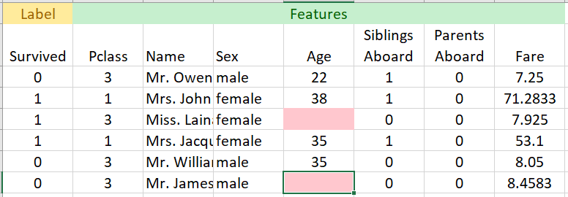
Titanic Data

Slide 39
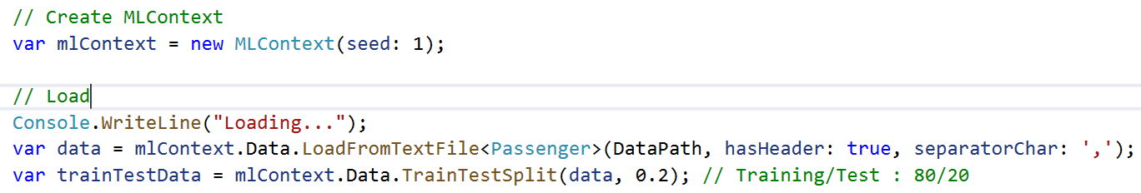
Load

Slide 40
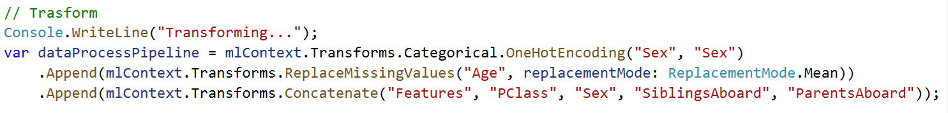
Load -> Transform

Slide 41
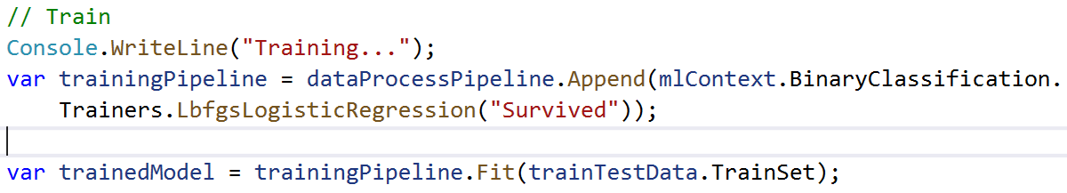
Load -> Transform -> Train

Slide 42
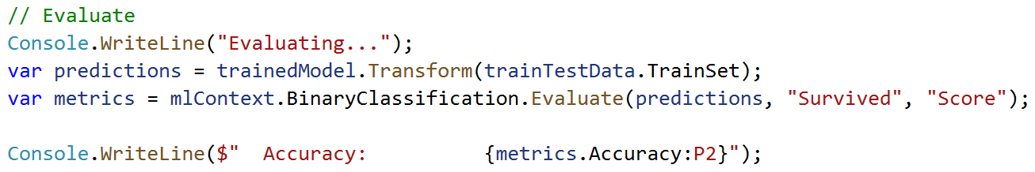
Load -> Transform -> Train -> Evaluate

Slide 43
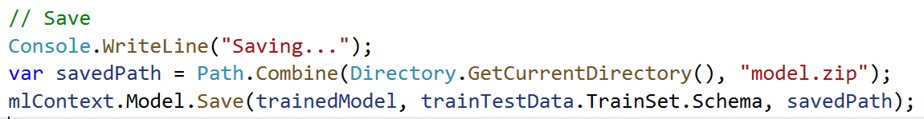
Load -> Transform -> Train -> Evaluate -> Save

Slide 44
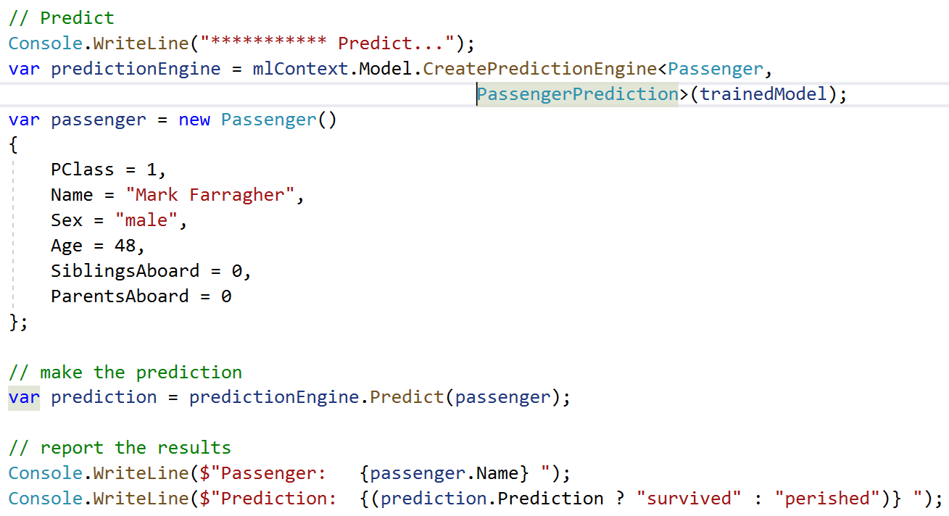
Load -> Transform -> Train -> Evaluate -> Save -> Predict

Slide 45
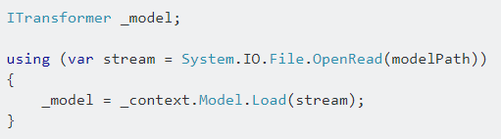
Load a model

Slide 46
AutoML – In Preview
S.No | Custom ML | AutoML
1. | Manually experiment with different algorithms | Runs different algorithms
2 | Time consuming in identifying best algorithm | Runs many algorithm without code changes
3 | Provides better control of algorithms | No control over algorithm selection
4 | Manually write code | Auto-generates code
mlnet auto-train --task binary-classification --dataset "titanic.csv" --label-column-index 0 --has-header true --max-exploration-time 30

Slide 47
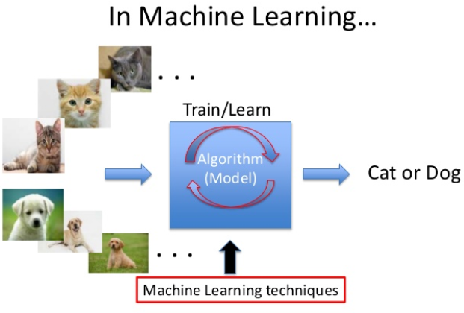
Interoperability
Photo-Search
ML.Net + ONNX
Keras CNN Model
No rewrite of algorithms/model
Save effort and time

Slide 48
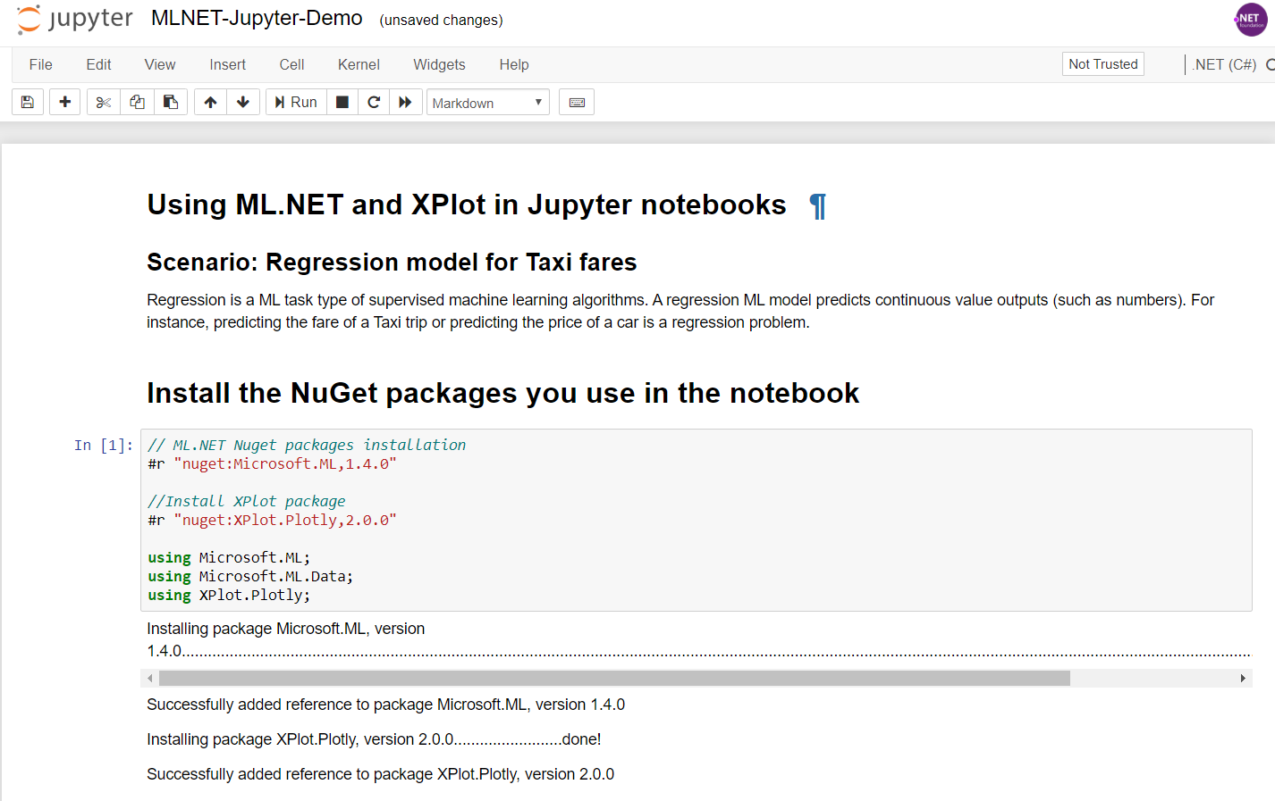
Jupyter Notebook – C#/F#
https://devblogs.microsoft.com/cesardelatorre/using-ml-net-in-jupyter-notebooks/

Slide 49
References
ML.Net : https://dotnet.microsoft.com/apps/machinelearning-ai/ml-dotnet
ML.Net: https://devblogs.microsoft.com/cesardelatorre/what-is-ml-net-1-0-machine-learning-for-net/
ONNX : https://onnx.ai/
Photo-Search (ONNX) : https://github.com/Tak-Au/Photo-Search
Music Repair : https://www.youtube.com/watch?v=nnV-1q-z9uE
ML Cookbook : https://github.com/dotnet/machinelearning/blob/master/docs/code/MlNetCookBook.md
Deploy to Azure functions : http://luisquintanilla.me/2018/08/21/serverless-machine-learning-mlnet-azure-functions/
https://rubikscode.net/2019/02/18/ultimate-guide-to-machine-learning-with-ml-net/
https://www.youtube.com/watch?v=dojO4zEL9sg
https://www.youtube.com/watch?v=zy7Y9CHji2k

Slide 50




Thank you Q & A
praveenraghuvanshi@gmail.com
https://in.linkedin.com/in/praveenraghuvanshi
https://github.com/praveenraghuvanshi1512
@praveenraghuvan

